Slide 1

Building a Book Recommendation Chatbot with IBM Watson Assistant
An IBM PBEL Virtual Internship Project

Slide 2
Project Overview
Empowering Book Discovery Through Conversational AI
This project details the development of a genre-based book recommendation chatbot using IBM Watson Assistant. Designed to simplify book discovery, the chatbot offers personalized suggestions through natural language interactions.
Project Name: Book Recommendation Chatbot using IBM Watson Assistant
Submitted By: Yash Singh, United College of Engineering And Research (Roll No: 2300100100482)
Submitted To: Mr. R Devnath (Faculty/Guide)

Slide 3
Declaration and Acknowledgement
Declaration
Acknowledgement
I, Yash Singh, hereby declare that this IBM PBEL Virtual Internship project, "Book Recommendation Chatbot using IBM Watson Assistant," is my original work. All efforts have been made to ensure the authenticity and integrity of the content and implementation.
I extend my sincere gratitude to Mr. R Devnath for his invaluable guidance and support throughout this project. I also thank the IBM PBEL team for providing this enriching virtual internship opportunity, and my college, United College of Engineering And Research, for fostering an environment conducive to learning and innovation.

Slide 4
Presentation Roadmap
1
Introduction
Setting the stage for the project and its objectives.
2
Technologies Involved
Deep dive into the core tools and platforms utilized.
3
Challenges & Solutions
Addressing hurdles faced during development and their resolutions.
4
Output Demonstration
Visualizing the chatbot in action with key screenshots.
5
Conclusion
Summarizing key takeaways and future potential.

Slide 5




Core Technologies: IBM Watson Assistant
The chatbot's intelligence is powered by IBM Watson Assistant, a robust AI platform designed for conversational interfaces.
Genre-Based Recommendations
Intent Recognition
Leverages the @genre entity to accurately identify and categorize user preferences, enabling precise book suggestions.
Defines key intents such as greet, recommend_book, and thanks for seamless conversational flow.
Robust Fallback Handling
Web Integration
Ensures a smooth user experience by gracefully managing unrecognized inputs and guiding users back to relevant topics.
Facilitates easy deployment and accessibility through simple integration with Watson Web Chat, minimizing setup complexity.

Slide 6




Understanding the Dialog Flow
The chatbot's conversational logic is structured to guide users efficiently from initial interaction to receiving book recommendations.
User Initiates Interaction
The conversation begins with a user greeting or a direct request for a book suggestion.
Assistant Identifies Genre
Watson Assistant's natural language processing detects the user's preferred genre using the pre-defined @genre entity.
Book Suggestions Provided
The chatbot dynamically responds with relevant book titles based on the identified genre.
Fallback for Unrecognized Inputs
A dedicated fallback node intelligently handles any inputs that the assistant does not recognize, maintaining a helpful interaction.

Slide 7

Seamless Website Integration
Integrating the chatbot into a website is straightforward, leveraging the power of Watson Web Chat for a client-side solution.
Script Tag Deployment
The chatbot is embedded into any webpage simply by adding a script tag, streamlining the deployment process.
Non-Intrusive Placement
The chatbot widget conveniently appears in the bottom-right corner of the site, ensuring accessibility without disrupting content.
Browser-Based Operation
Requires no backend code, functioning entirely within the user's browser for quick and easy setup.

Slide 8
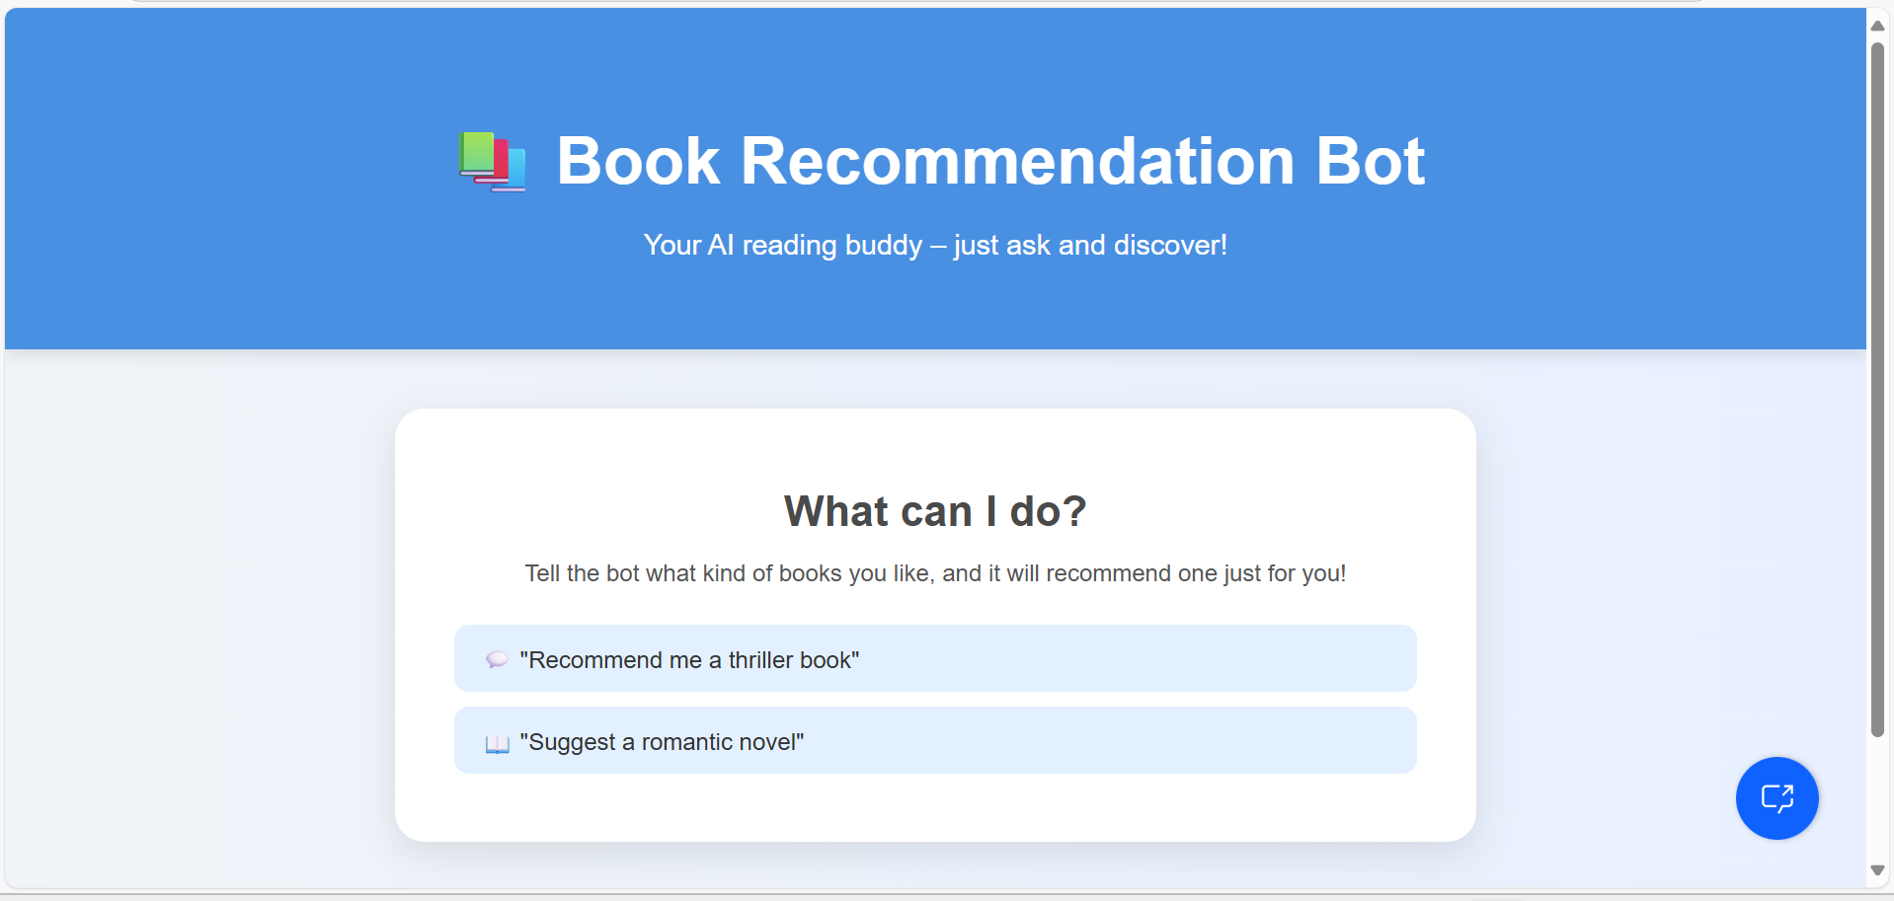

Output Screenshot
See the Book Recommendation Chatbot in action, demonstrating its intuitive interface and genre-based suggestions.

Slide 9
Conclusion & Future Scope
The IBM Book Recommendation Chatbot stands as a testament to the power of conversational AI in simplifying user experiences.
Simplicity and Effectiveness: A concise yet effective solution for book discovery, focusing exclusively on genre-based recommendations.
Easy Deployment: Built using IBM Watson Assistant, demonstrating remarkable ease of deployment.
Future Enhancements: Potential for expansion to include author-based recommendations, sentiment analysis for personalized suggestions, and integration with external APIs for real-time book availability and reviews.

